Slide 1
Heart Disease Prediction Using Machine Learning Algorithms
Presented By:
Mathangi Tharun
Kakatiya Institute of Technology And Science
Computer Science And Engineering

Slide 2
OUTLINE
Problem Statement
System Development Approach
Algorithm & Deployment
Result
Conclusion
Future Scope
References

Slide 3
Problem Statement
This project uses the K-Nearest Neighbors (KNN) algorithm to predict outcomes early in the identification of heart disease. Patient data was analyzed to assess if an individual had heart disease. The accuracy of the model was evaluated to ensure its dependability.

Slide 4
System Approach
System requirements
Jupyter Notebook or Anaconda
Python(Version 3.7 or higher)
Windows, macOS, or Linux
Hardware Requirements
Processor: Intel Core i5 or higher
RAM: 8 GB or higher
Storage: 250 GB

Slide 5
Library required to build the model
Library required
Pandas
NumPy
Scikit-learn
Matplotlib and Seaborn

Slide 6
Algorithm & Deployment
Step 1: Data Acquisition
I downloaded the dataset from Kaggle in CSV format.
Step 2: Library Import
I have imported the following libraries:
pandas for data manipulation.
NumPy for numerical operations.
matplotlib and seaborn for data visualization.
Step 3: Data Loading
Using pandas, I loaded the CSV file into the Jupyter notebook for further analysis.

Slide 7
Algorithm & Deployment
Step 4: Data Inspection
I counted the values present in each column to understand the distribution of the data.
Step 5: Missing Data Analysis
I checked for missing or null values using pandas, but found there were no missing or null values
in the CSV file.
Step 6: Outlier Detection
I performed an analysis to detect outliers using seaborn's boxplot function. Some outliers were
identified but were not removed at this stage.

Slide 8
Algorithm & Deployment
Step 7: Data Visualization
I performed visualization using the seaborn and matplotlib libraries.
Used count plot to examine the target distribution of sex
Applied a correlation heatmap to explore correlations between the features.
Step 8: Data Processing
I used scikit-learn to convert categorical variables (strings) to integers.
The data was normalized using Min-Max-Scaler to scale the features into a range suitable for machine learning.
I applied train-test-split to split the data into training (80%) and testing (20%) sets.

Slide 9
Algorithm & Deployment
Step 9: Model Building and Evaluation
I employed the KNN algorithm to build the prediction model.
Using the accuracy-score, I evaluated the model's performance and achieved an accuracy of approximately 88%.
Step 10: Deployment of The Project
I have deployed it in the GitHub.

Slide 10
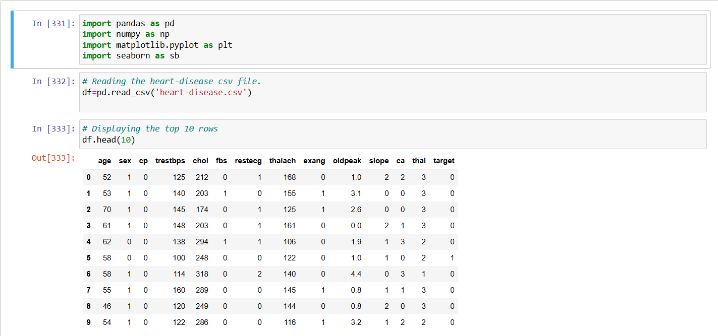
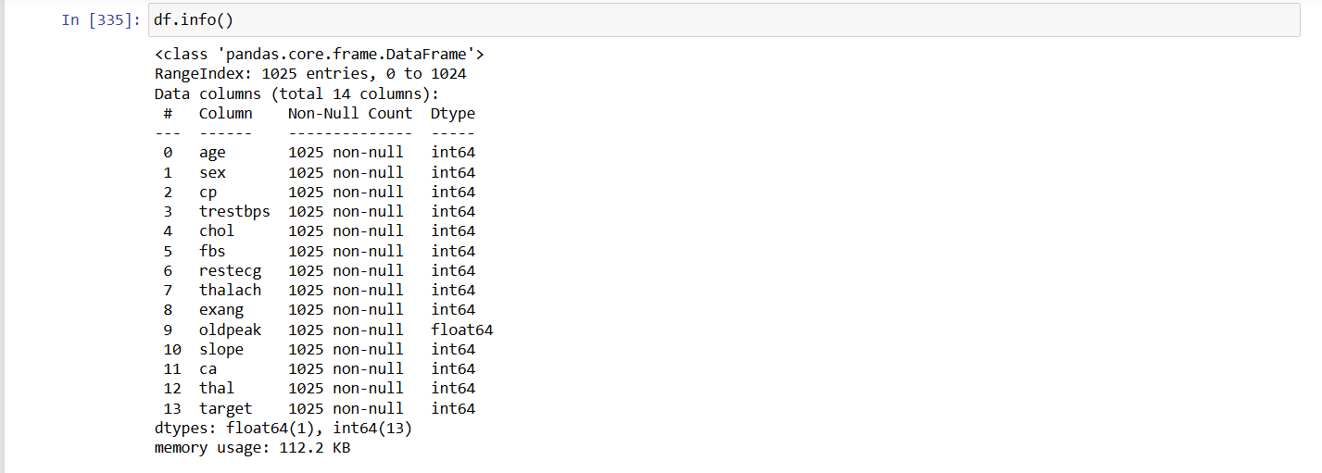
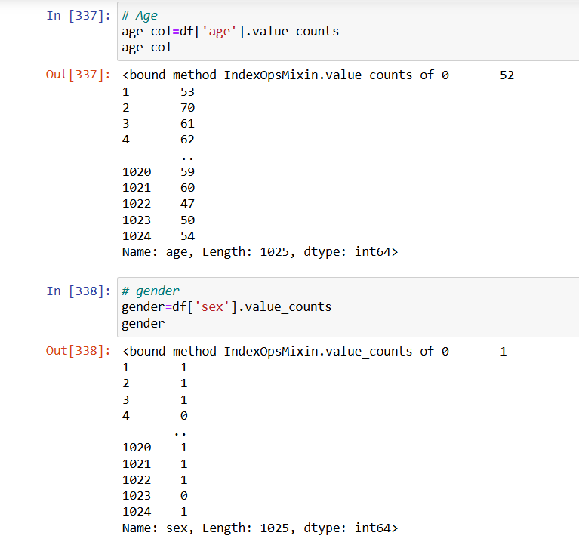
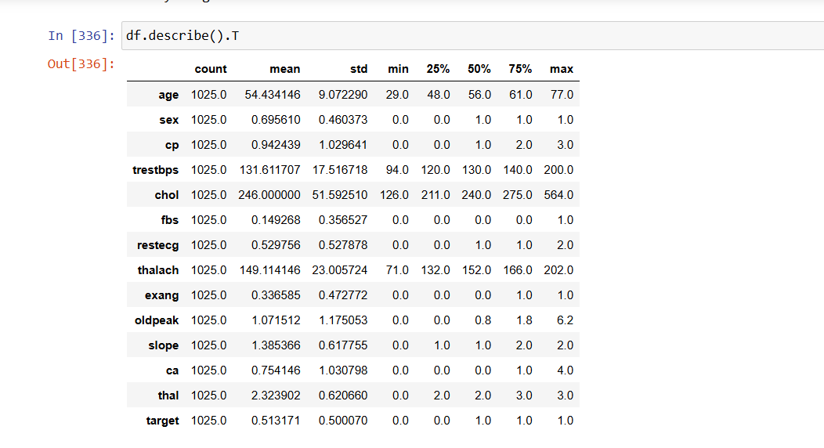
Results

Slide 11
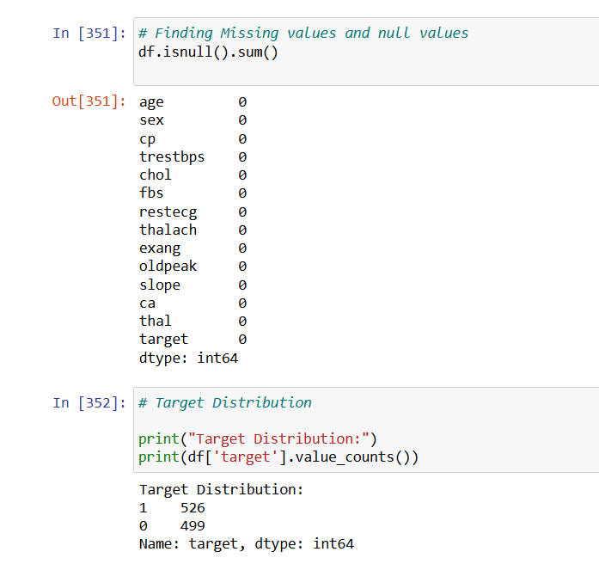
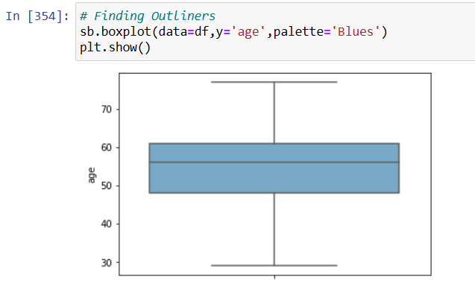
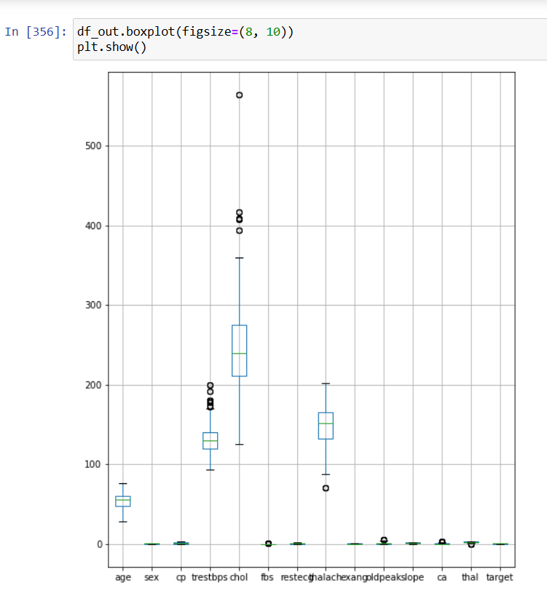
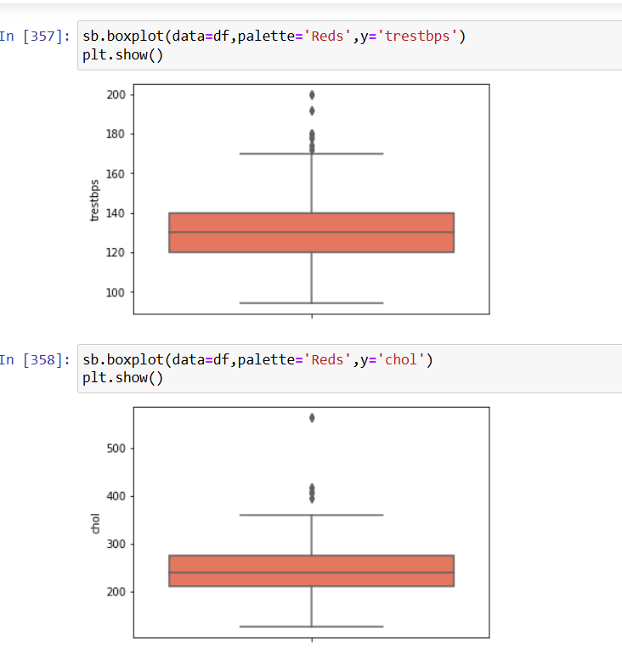
Results

Slide 12
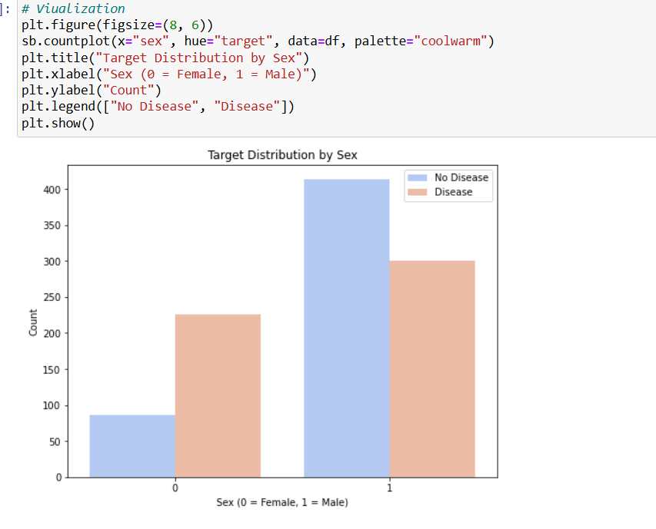
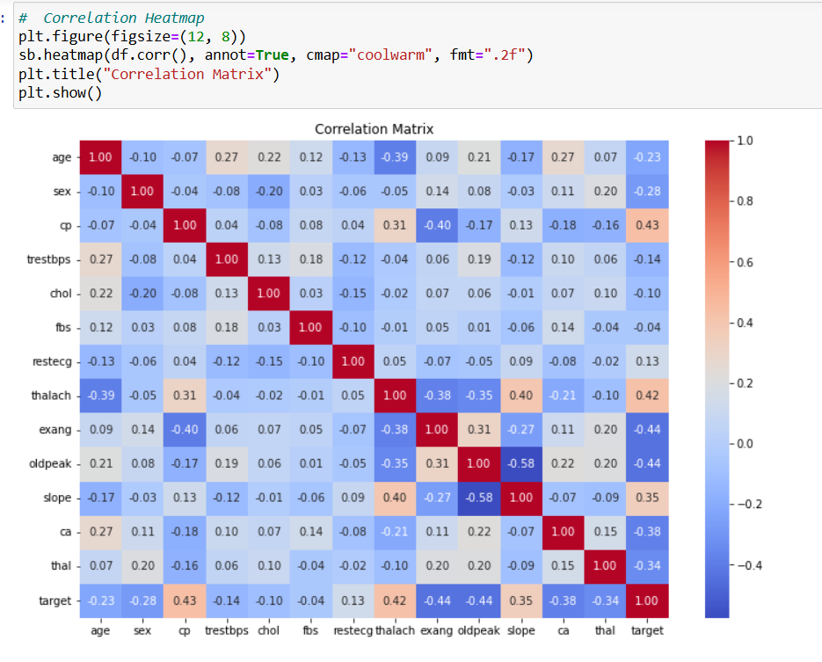
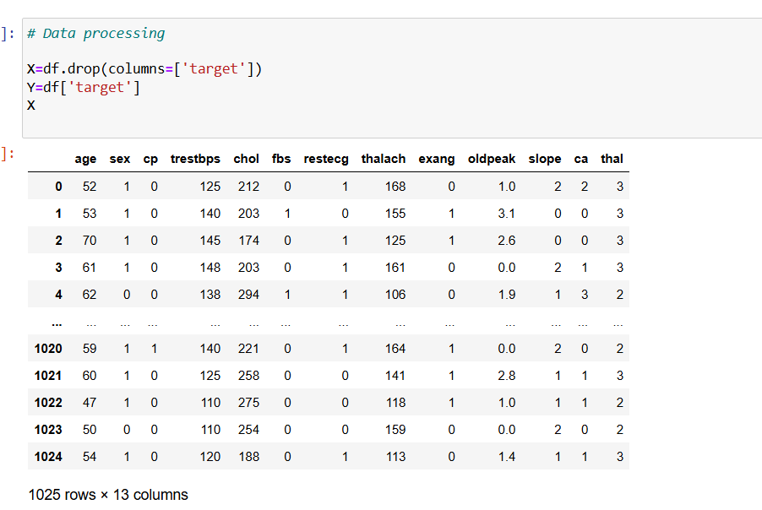
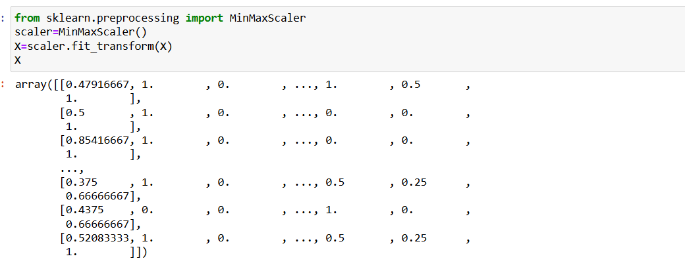
Results

Slide 13
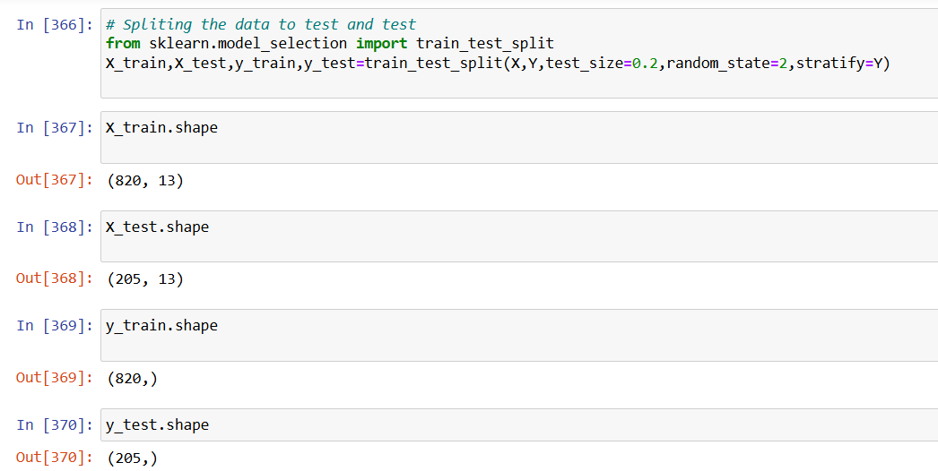
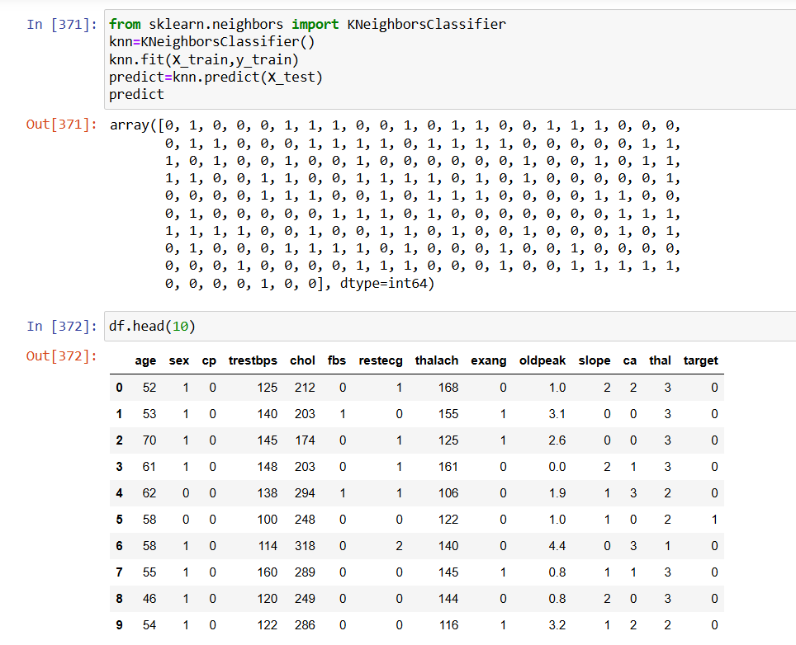
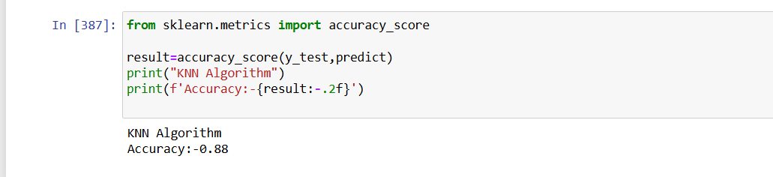
Results

Slide 14
Conclusion
This project demonstrates how heart conditions can be predicted using the K-Nearest Neighbors (KNN) algorithm. Healthcare providers can use the model to prioritize testing and treatments by using medical data to identify high-risk individuals. This could improve the efficiency of healthcare. To make the model more accurate in the future, we can tweak its parameters, experiment with various distance-measuring strategies, and investigate more machine learning approaches.

Slide 15
Future scope(Optional)
This project can be improved in a number of ways going forward:
Adjusting the KNN's parameters to increase accuracy is known as hyperparameter tuning.
Real-Time Data: To test the model and increase its use for routine healthcare, real data is used.
Cross-validation: Verifying that the model performs well across all scenarios by comparing its performance across various datasets.

Slide 16
References
https://www.kaggle.com/datasets/johnsmith88/heart-disease-dataset

Slide 17
THANK YOU

